Slide 1
Salmonellosis
Assist. Prof. Dr. Hussein ALNaji

Slide 2
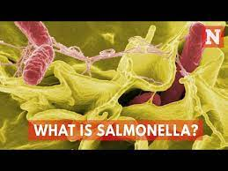
Salmonellosis Salmonellosis is a zoonotic disease which means that it can be transmitted between animals and humans. The disease is caused by a group of bacteria called Salmonella of which their are many species that can affect humans. The disease produced usually varies with the serotype of Salmonella involved. The agent is very common in the environment. It is found in water or feed contaminated by infected animals. Salmonella are readily destroyed by most disinfectants.

Slide 3
Zoonotic potential
1- Salmonellosis is the second most common zoonotic disease after campylobacteriosis in the EU, and Salmonella is a common cause of foodborne disease outbreaks.
2- Most of the isolates that cause disease in humans and other mammals belong to S. enterica subsp. enterica. A few serovars—Salmonella ser. Typhi, Salmonella ser. Paratyphi
and Salmonella ser. Hirschfeldii—are human pathogens.
3- They are transmitted mainly from person-to-person and have no significant animal reservoirs.
4- The remaining Salmonella serovars, sometimes referred to as nontyphoidal Salmonella, are zoonotic or potentially zoonotic. The most common serovars infecting humans worldwide are Salmonella ser. Typhimurium and Salmonella ser. Enteritidis.

Slide 4
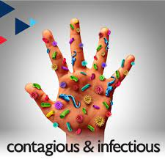
Transmission
1- People are often infected when they eat contaminated foods of animal origin. Eggs are a major source of Salmonella, Meats such as poultry and pork beef, fish, and reptile meat, among others.
2- Outbreaks associated with non-animal foods, such as fresh produce and peanut butter and contaminated water.
3- Directly transmitted human infections are most often acquired from reptiles, amphibians, and poultry (e.g., chicks and ducklings).
4- Humans shed bacteria throughout the course of the infection. Shedding can last for several days to several weeks and months.

Slide 5
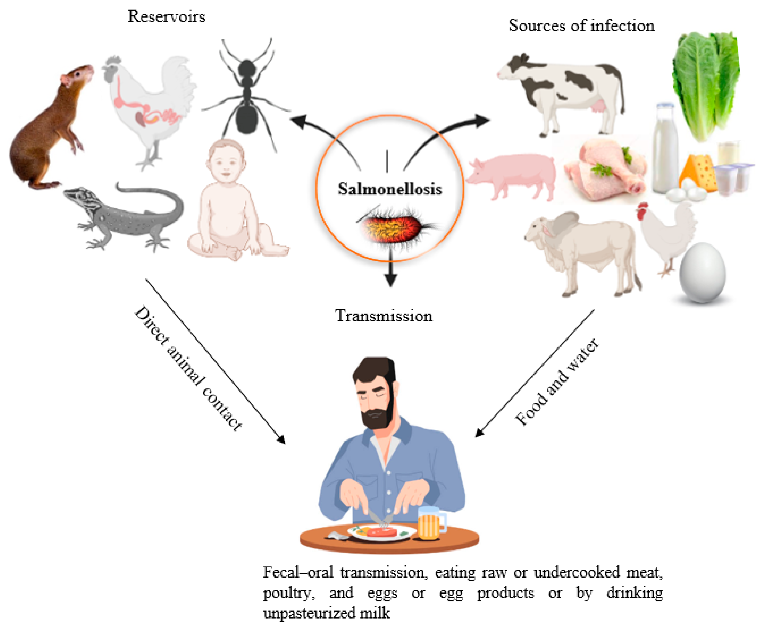

Slide 6
Symptoms
Infections in Humans
1- Incubation Period for Salmonella gastroenteritis in humans is usually 6 hours to 3 days, although periods up to14 days have been reported. Enteric fever usually appearsafter 10 to 14 days.
2- Salmonella cause Gastroenteritis, Systemic disease and Focal disease

Slide 7
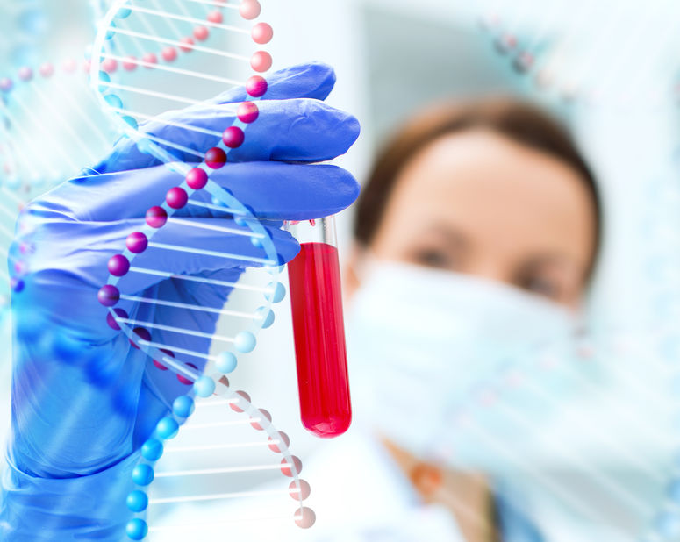
Diagnostic Tests
As in animals, salmonellosis can be confirmedby isolating the organisms from feces or, in cases of disseminated disease, from the bone marrow or blood.
In humans, bone marrow cultures are considered to be most sensitive. When using blood and stool, multiple samples may be tested

Slide 8
Prevention
1- The best way to prevent getting Salmonella from animals is to always wash your hands for 20 seconds with soap and running water immediately after touching animals, their food or treats, items in their environments, and their poop.
2- Children under 5 years old should not handle animals that are likely to spread Salmonella (like reptiles, amphibians, rodents, and poultry).
3- Never eat or drink around these animals, or in areas where they live and roam. Keep animals away from areas where food and drinks are prepared, served, or stored, such as kitchens or outdoor patios.

Slide 9
Thank you

